Slide 1
Week 6
CIS 347 / SOC 395
Computer Crime Law

Slide 2
Computer Crimes
Cyber-Crime: “Any crime that uses modern telecommunication networks”
Seems to exclude a lot of crimes that utilize technology, but don’t access the Internet, SMS, Bluetooth, cellular networks, etc. doesn’t it? Yes. Yes, it does.
Computer Crime: Includes cyber-crime, but includes many other crimes as well. There is no hard-and-fast definition here, but essentially it boils down to
Computer as a target
Computer as a tool
Computer as an object
Computer as a symbol
Also keep in mind that the definition of “computer” here extends to any device, such as mobile, GPS, printers, whatever.

Slide 3
Any crime can create digital evidence
1. Computer to commit crime: these are commonly known as “cyber crimes”
a. Illegal access to computer systems permits criminals to accomplish the activities described below
b. Interference with data or computer systems by malicious programs can destroy data or result in theft of information
c. Online identity theft is a huge problem that costs the world billions of dollars each year, and victimizes businesses, governments, and individuals
2. Computer to store evidence of crime
a. Child pornography; digital photographs and the Internet have facilitated an explosion in child exploitation and pornography
b. Pirated movies and other intellectual property are usually found in digital format
c. Records of criminal transactions: everyone keeps records on computers, including the criminals
3. Computer for communication
a. E-mail, instant messaging, and Internet chat rooms
b. Voice and video communications
c. Transfer documents and photographs

Slide 4
As a Target, Object, Symbol or Tool
Computer as a target/subject:
Cyber-terrorism
Vandalism
Hacking
Computer as a tool/instrument:
Extortion
Wire Fraud
Data Theft
Piracy
Harassment
Child exploitation

Slide 5
As a Target, Object, Symbol or Tool
Computer as an object:
Hardware theft
Computer as a symbol:
More difficult to explain but imagine a crime where the offender only makes claims related to the computer.
Crimes against:
Individuals – cyberstalking, harassment, targeted attacks
Property – infrastructure, data centers, corporate attacks
Government – protests/activism, cyber-warfare

Slide 6
To help define:
The computer as a TOOL or INSTRUMENT… The computer is a means to an end. The criminal USES the computer…
Same as Mark USED the KNIFE to stab Sam.
The computer as a TARGET or SUBJECT… The crime is committed against a VICTIM and the computer is the avenue of attack…
Data diddling
DDOS
The computer as an OBJECT… The victim is inconsequential – the computer itself is the target…
Piracy
Theft

Slide 7
Computer Involvement in Crime
Hardware as Contraband or Fruits of Crime
A stolen computer (fruits)
A device that can intercept cell phone calls (contraband)
Hardware as an Instrumentality
Bludgeoning someone with a computer
A hardware sniffer
Hardware as Evidence
A scanner collected as evidence to examine it for unique characteristics.
Information as Contraband or Fruits of Crime
Child pornography (contraband)
Pirated software (fruits)
Information as an Instrumentality
Hacking utilities
Information as Evidence
Pretty much all digital evidence, like logs, ISP records, etc.

Slide 8
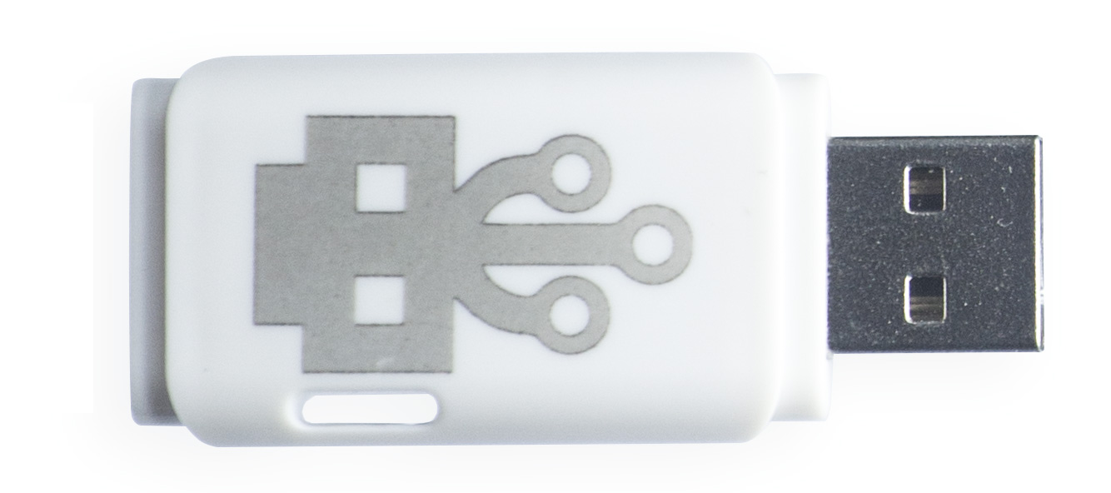
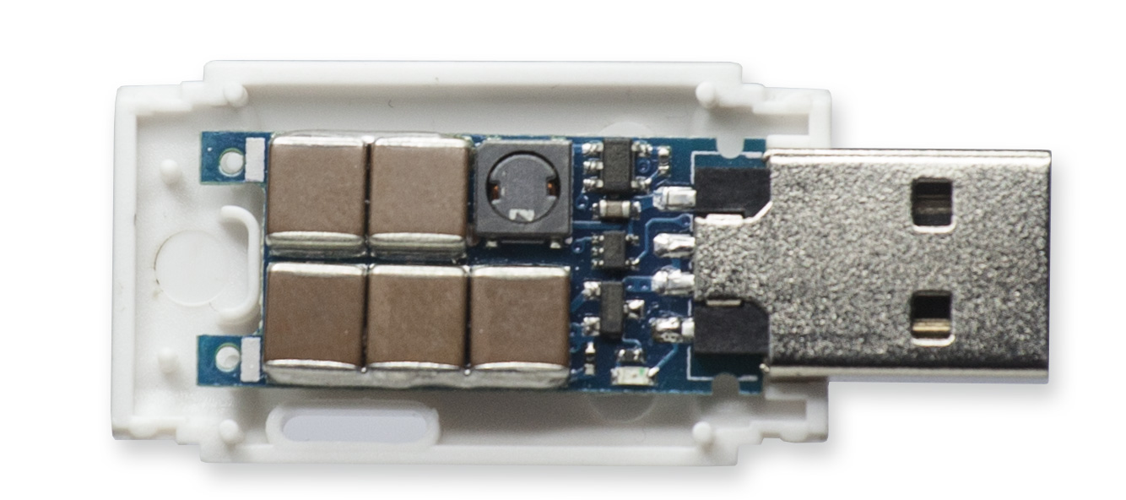

Slide 9
Computer Crime Complications
Computers acting without the knowledge of the owner:
Botnet zombies
Automated attacks, dead-man’s switches
Users acting without the knowledge of the computer
Social engineering
A variety of computer criminals:
State actors
Script kiddies
Curious criminals
Intrinsic/extrinsic targets
Detection of crimes, identification of criminals, jurisdiction issues & foreign criminals, effort vs. likelihood of conviction.

Slide 10
It’s so simple, right?
From a 1991 article on the “new problem” of cybercrime:
There are four major categories of computer crime:
internal computer crimes--trojan horses, logic bombs, trap doors, worms, and viruses;
telecommunications crimes--phreaking and hacking;
computer manipulation crimes that result in embezzlement and fraud;
traditional thefts of hardware and software.

Slide 11
Computer Crime Laws
The technological explosion of the last three decades caught the world off guard.
The legal system especially was not prepared for the Internet.
The Internet has been a source of legal concern from the very beginning. In the early days there was absolutely no law enforcement presence on the Internet.
Even when business first got involved in the mid 90s, it took years for law enforcement to catch up.
Think of it like Manifest Destiny – rapid expansion of territory with little to no government presence – the Old Internet was the Wild West.

Slide 12
What’s Old is New
Horse Laws – Before the automobile, our primary means of conveyance aside from walking was horses. When automobiles came around, the law found new legal questions to answer, and stretched horse laws (ancient in some cases) to automobiles.
The same is true for modern technologies (like stretching the tort of trespass to chattels to address spam.)

Slide 13
Computer Horse Laws
Posse Comitatus Act of 1879
Antitrust Laws and Section 5 of the Federal Trade Commission Act
National Institute of Standards and Technology Act
Federal Power Act
Communications Act of 1934
National Security Act of 1947
U.S. Information and Educational Exchange Act of 1948 (Smith-Mundt Act)
Federal Wire Fraud Act, 1952
State Department Basic Authorities Act of 1956
Freedom of Information Act (FOIA)
Omnibus Crime Control and Safe Streets Act of 1968
Racketeer Influenced and Corrupt Organizations Act (RICO)
Federal Advisory Committee Act (FACA)
Privacy Act of 1974

Slide 14
Business Brings Laws
The commercialization of the Internet is what really finally brought attention over lawmakers and law enforcers. Suddenly money was at stake, and the free market dictates that it be made less free.
Domain name disputes. (Panavision v. Toeppen)
Trademarks
Enforceability of online contracts
Copyright issues

Slide 15
Social Media
Horse laws exist for crimes of an interpersonal nature as well, which is complicated by modern telecommunications:
Anyone remember MySpace? It went online in 2003 and was a social media precursor to Facebook. (See: Doe v. MySpace…)
2004 - Facebook (see: Facebook v ConnectU, Smith v Facebook, Patel v Facebook, Lane v Facebook, Fraley v Facebook, SIN v Facebook…)
2005 – YouTube (see: Viacom v YouTube, Puls 4 v YouTube, Kinney v YouTube, and Nasim Aghdam…)
2006 – Twitter (see: Knight Institute v. Trump, People v Harris, Murphey v Twitter, Crosby v. Twitter, Fields v Twitter, Johnson v Twitter, Brittain v Twitter, Pennie v Twitter…)

Slide 16
Social Media
Social media sites haven’t just been the subject of court cases – they are platform to facilitate crimes as well.
Wolfe v. Fayetteville School District, where fellow students started a hate group on FB – “Every One That Hates Billy Wolfe” which included a photoshopped picture of the kid on the body of a green fairy with the word HOMOSEXUAL over it.
US v. Drew where Lori Drew created a fake MySpace profile of a 16 year old boy and catfished a girl in the neighborhood. Eventually used the account to convince/bully her into suicide. She was indicted on charges of conspiracy and violations of the CFAA. She was eventually acquitted of all charges – prompting many states to amend their harassment laws to include cyberbullying/stalking.

Slide 17
Jurisdiction
The crimes on the Internet like Wolfe v. FSD and US v Drew are actually the easy ones – perpetrator and victim in the same jurisdiction. Imagine the complexity when the victim and perpetrator reside in different countries.
Civil jurisdiction is simpler than criminal – torts are torts and settled case-by-case. The problem in most cases is that not all countries share our due process model.

Slide 18
Jurisdiction
General personal jurisdiction
Goodyear Dunlop Tires Operations, S.A. v. Brown and Daimler AG v. Bauman, a company doing business on the Internet may be sued for any reason in the jurisdiction where it is "at home," typically its place of incorporation. Because general jurisdiction is now quite limited, courts will often look to specific personal jurisdiction to determine whether a company is amenable to suit in a given jurisdiction.
Specific personal jurisdiction
Allows a defendant to be sued in a forum on the basis of the defendant's contacts with the forum. A court can establish specific jurisdiction over a defendant only if he or she has "certain minimum contacts." .
“Minimum contacts” for crimes over the Internet mean “active contacts with a forum,” such as Internet sales to the forum residents, conducting business in the forum state through numerous contacts, or entering into specific dealings with forum residents.

Slide 19
“Minimum Contacts”
The United States Supreme Court decided in 1945 in the case of International Shoe v. Washington that for a defendant to be hailed into court in a particular jurisdiction it must have at least a minimum level of contact with that state that it could reasonably expect to be sued in the courts of that state.
Following International Shoe, courts have generally applied a three-part test in evaluating minimum contacts sufficient for jurisdiction:
(1) The nonresident defendant must do some act or consummate some transaction with the forum or perform some act by which he purposefully avails himself of the privilege of conducting activities in the forum, thereby invoking the benefits and protections[;]
(2) the claim must be one which arises out of or results from the defendant's forum-related activities[; and]
(3) exercise of jurisdiction must be reasonable.

Slide 20
“Effects” or “Calder” Test – “Purposeful Direction”
Courts may also apply the "effects" test from Calder v. Jones, 465 U.S. 783 (1984), in cases with insufficient interactivity or minimum contacts, but where an action is targeted at a particular forum.
In Calder, a California resident in the entertainment business sued the National Enquirer, located in Florida, for libel based on an allegedly defamatory article published by the magazine. While the article was written and edited in Florida, the Court found that personal jurisdiction was properly established in California because of the effects of the defendants' conduct in that state. As the article concerned a California resident with a career in California and relied on California sources, the Court found the defendants' "intentional, and allegedly tortious, actions were expressly aimed at California."

Slide 21
“Effects” or “Calder” Test – “Purposeful Direction”
In the Internet context, the effects test can be used to examine the exact nature of a defendant's Internet activities to determine whether its out of state actions were directed at parties or entities within the forum state. This is referred to in the language of Calder v. Jones as "purposeful direction," which requires:
(a) an intentional action, that was
(b) expressly aimed at the forum state, with
(c) knowledge that the brunt of the injury would be felt in the forum state.
If a court finds that a defendant's actions meets the standard of purposeful direction, then personal jurisdiction may be asserted based on Internet activities which do not meet the requisite level of interactivity or minimum contacts needed for other tests of personal jurisdiction in Internet cases.

Slide 22
“Sliding Scale” or “Zippo” Test
In Zippo Manufacturing Co. v. Zippo Dot Com, Inc., a Federal Court held that
"the likelihood that personal jurisdiction can be constitutionally exercised is directly proportionate to the nature and quality of commercial activity that an entity conducts over the Internet. This sliding scale is consistent with well developed personal jurisdiction principles.“
Although no bright-line test exists, most courts have applied an "interactive-passive" distinction when determining personal jurisdiction over someone operating a Web Site. Generally, courts have conferred personal jurisdiction in cases where "interactive" uses of the Internet have taken place within the state.
Interactive contact encompasses two-way online communication which fosters an ongoing business relationship
“Passive" contacts are those that simply make information available to interested viewers.

Slide 23
Internet Police
Who enforces the law on the Internet? Everyone. No one. Who knows?
While the FBI still tends to be the leader in forensic examination (including digital evidence) – FBI also enforces law for interstate crimes per pre-existing mandate.
DEA – Drug trafficking and associated.
The Secret Service by virtue of existing duties prior to the Internet, then specifically by the USPATRIOT Act.
The FTC (Federal Trade Commission) is the policing force for Internet commerce, including unfair or deceptive practices.
The FCC governs things related to publishing and broadcasting. Particularly – cell phone coverage.
State/municipal LEOs – still police activity intra-state, but don’t really have the resources.
Wisconsin Statewide Intelligence Center
National intelligence agencies – NDA, DHS, CIA

Slide 24
State Internet Laws
WIS 134.98 – Data Breach Notification
Requirement to notify within 45 days if personal information is leaked.
Wisconsin stalking statutes have been amended to include cyber-vectors.
WIS § 947.0125 Unlawful use of computerized communications
Involves annoying or threatening communications via a computer, such as those sent through electronic mail or via Facebook. Includes when the bully intended only to harass or annoy the victim, such as by sending repeated and unwanted obscene emails. But it becomes a misdemeanor when the bully intended to seriously frighten or threaten the victim. (Criminal harassment – 947.013)

Slide 25
State Internet Laws
WIS 943.70 Computer Crimes
Whoever willfully, knowingly and without authorization does any of the following:
Accesses, copies, modifies, takes possession of, or destroys data, computer programs or supporting documentation. OR,
Discloses restricted access codes or other restricted access information to unauthorized persons.
Whoever intentionally causes an interruption in service by submitting a message, or multiple messages, to a computer, computer program, computer system, or computer network that exceeds the processing capacity of the computer, computer program, computer system, or computer network.

Slide 26
Federal Computer Laws
Computer Fraud and Abuse Act of 1986
Electronic Communications Privacy Act of 1986 (ECPA)
Department of Defense Appropriations Act, 1987
High Performance Computing Act of 1991
Communications Assistance for Law Enforcement Act of 1994 (CALEA)
Communications Decency Act of 1996
Child Pornography Prevention Act, 1996
Clinger-Cohen Act (Information Technology Management Reform Act) of 1996
Identity Theft and Assumption Deterrence Act of 1998
Federal Information Security Management Act of 2002 (FISMA)
Digital Millennium Copyright Act
Cyber Security Research and Development Act, 2002
E-Government Act of 2002
Intelligence Reform and Terrorism Prevention Act of 2004 (IRTPA)

Slide 27
Timeline
Comprehensive Crime Control Act of 1984 – Signed by Reagan, had many constituent parts that included expanding the US SS jurisdiction over credit card and computer fraud.
Computer Fraud and Abuse Act (CFAA) of 1986 was written to increase the scope of the fraud sections of the CCCA. It was intended to limit federal jurisdiction to cases with “a compelling federal interest” though, of course, that didn’t last long.

Slide 28
CFAA
As computer crimes continued to grow in sophistication and as prosecutors gained experience with the CFAA, the CFAA required further amending, which Congress did in 1988, 1989, 1990, 1994, 1996, 2001, 2002, and 2008.
By this time, the definition of coverage of the CFAA is essentially the fullest extent of Congress’ commerce powers. Any computer engaging in, connected to, or affecting inter-state commerce.

Slide 29
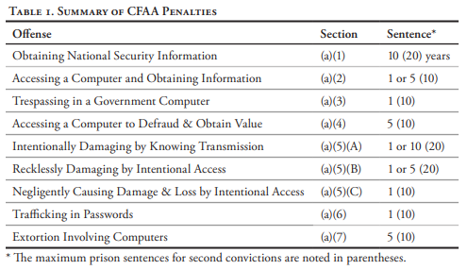
CFAA Offenses & Penalties

Slide 30
CFAA Civil Penalites
In some circumstances, the CFAA also provides for a civil cause of action if a plaintiff can demonstrate the following:
loss to 1 or more persons during any 1-year period aggregating at least $5,000 in value;
the modification or impairment, or potential modification or impairment, of the medical examination, diagnosis, treatment, or care of 1 or more individuals;
physical injury to any person;
a threat to public health or safety;
damage affecting a computer used by or for an entity of the United States Government in furtherance of the administration of justice, national defense, or national security; or
damage affecting 10 or more protected computers during any 1-year period.

Slide 31
Currently extent of the CFAA
Section 1030(e)(2) defines protected computer as a computer—
(A) exclusively for the use of a financial institution or the United States Government, or, in the case of a computer not exclusively for such use, used by or for a financial institution or the United States Government and the conduct constituting the offense affects that use by or for the financial institution or the Government; or
(B) which is used in or affecting interstate or foreign commerce or communication . . . .
Note that the computer must be “used in or affecting” not “used by the defendant in”—that is, it is enough that the computer is connected to the Internet; the statute does not require proof that the defendant also used the Internet to access the computer or used the computer to access the Internet.

Slide 32
CFAA
Several of the criminal offenses in the CFAA require that the defendant access a computer “without authorization.” See 18 U.S.C. §§ 1030(a)(3), (a)(5)(B), (a)(5)(C).
Others require that the defendant either access a computer “without authorization” or “exceed authorized access.” See 18 U.S.C. §§ 1030(a)(1), (a)(2), (a)(4).
The CFAA defines “exceeds authorized access” as “to access a computer with authorization and to use such access to obtain or alter information in the computer that the accessor is not entitled so to obtain or alter.”2 18 U.S.C. § 1030(e)(6).

Slide 33
Note to the CFAA
Aaron’s Law:
In 2011, Aaron connected to an MIT network in an unmarked closet and began downloading scholarly articles form JSTOR using a guest user account issued by MIT.
He was charged with 2 counts of wire fraud and 11 counts of violations of the CFAA. He was facing $1 million in fines and 35 years of prison for downloading with intent to share data – scholarly articles from studies funded in part or in whole by tax payer dollars, which regular tax payers do not have access to due to the academic paywall.
He committed suicide while under indictment for these crimes, after rejecting a plea deal to serve 6 months in prison.
There is a proposed amendment to the CFAA which would exclude certain crimes from the act. However, it has stalled twice in committee due largely to large tech company interests blocking it (see: Oracle.)

Slide 34
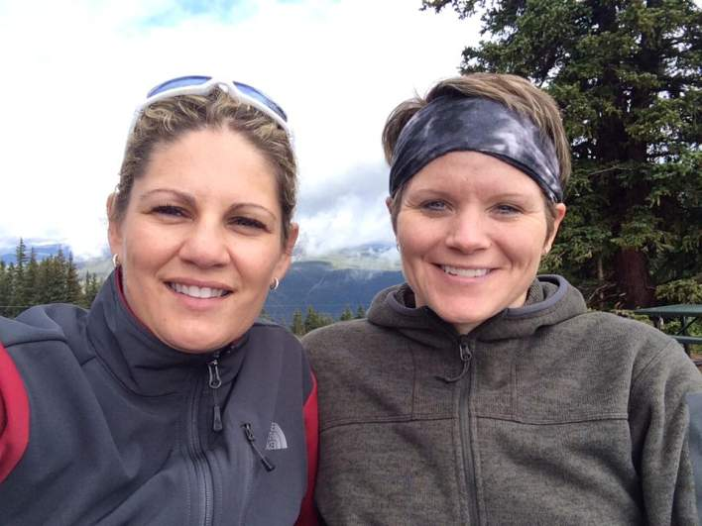
Space Crime!

Slide 35
Space Crime!
The first alleged crime committed in space was a cyber-crime. A violation of the CFAA – unauthorized access.
Anne McClaine, astronaut in the ISS allegedly accessed her estranged wife Summer Worden’s account “to take care of the couple’s co-mingled finances.”
Complaint filed with CTF and NASA OIG
USC 51 – Space Laws. “This civil space station may be used only for peaceful purposes” USC 51 SS 70901 Numerous treaties give jurisdiction to the nation from which an astronaut originates., Hence CFAA (USC SS 1030 )

Slide 36
Timeline
1986 is also the year the Electronic Communication Privacy Act was passed (18 U.S.C. §§ 2510-2523.) It has three titles:
Title I aka the Wiretap Act.
Title II aka the Stored Communication Act (SCA)
Title III for pen register trap and trace devices

Slide 37
ECPA – Title I
The Wiretap Act prohibits the intentional (actual or attempted) interception or disclosure of any wire, oral, or electronic communication. (substantive)
And prohibits the use of illegally obtained communications as evidence. (procedural) So a warrant is required to seize these communications as evidence.
Note that this is federal – each state has their own wiretap laws. Wisconsin, for example, is a “one-party consent” state. Some state require all party’s consent.

Slide 38
ECPA – Title II
The Stored Communications Act applies the principles of Title I to the content of files stored by service providers, and records held my those providers (subscriber information like name, address, IP, etc.)
Exceptions to this exist. Student information under FERPA for example can be released if it is “directory information.”
Again – federal only. Wisconsin has some really weird Open Records laws.

Slide 39
ECPA – Title III
This title requires a warrant be issued before the installation and use of a pen register (a device that captures the dialed numbers and related information of outgoing calls), and/or a trap and trace (a device that captures the numbers and related information of incoming calls.)
Is substantive as well as procedural – if law enforcement requires a court order before this is legal – then it is illegal for non-law enforcement to do it without a court order, and non-law enforcement cannot obtain a court order.

Slide 40
Timeline
1991 – The first time the term “The Internet” is used in court. After a hacker was convicted of gaining unauthorized access to BellSouth’s computer files and publishing the proprietary information in a newsletter.
1991 – Also the first year an ISP was sued for defamatory statements made by a subscriber. In Cubby, Inc. v. CompuServe, Inc. the federal rules CompuServe was NOT liable for the statements made by a subscriber, laying the groundwork for ISPs as a distributor of content, rather than a publisher.
1993 – The first trademark case, where a federal court found a bulletin board liable for copyright infringement when a poster put up images from Playboy.

Slide 41
Timeline
1996 – the Child Pornography Prevention Act is passed.
The act criminalized the production, distribution, and reception of electronic images feature sexual depictions of children.
Includes sexual images of adults doctored to resemble children and drawings/computer generated depictions of children provided the materials are “obscene.” (So loli/shota is technically illegal.)
We will talk about Constitutional Law on the Internet next week, but another act, the Communications Decency Act, was struck down in part by the Supreme Court. The provisions the Court rejected covered "indecent" and "patently offensive" materials, which are entitled to higher First Amendment protection than obscene materials.

Slide 42
CPPA - Findings
(5) new photographic and computer imaging technologies make it possible to produce by electronic, mechanical, or other means, visual depictions of what appear to be children engaging in sexually explicit conduct that are virtually indistinguishable to the unsuspecting viewer from unretouched photographic images of actual children engaging in sexually explicit conduct;
(6) computers and computer imaging technology can be used to—
(A) alter sexually explicit photographs, films, and videos in such a way as to make it virtually impossible for unsuspecting viewers to identify individuals, or to determine if the offending material was produced using children;
(B) produce visual depictions of child sexual activity designed to satisfy the preferences of individual child molesters, pedophiles, and pornography collectors; and
(C) alter innocent pictures of children to create visual depictions of those children engaging in sexual conduct;

Slide 43
The 5000-year-old demon quandary
Loli – Shota – whatever – depictions of children in sexual situations that most people think skirts the CPPA because
1)It is a drawing. Purely fictional.
2) In the story, the character only looks like a child. They are really a 5000-year-old-demon (or witch, or robot, or whatever.)
(8) ‘child pornography’ means any visual depiction, including any photograph, film, video, picture, or computer or computer-generated image or picture, whether made or produced by electronic, mechanical, or other means, of sexually explicit conduct, where—
(B) such visual depiction is, or appears to be, of a minor engaging in sexually explicit conduct;

Slide 44
CPPA – Computer Considerations
The CPPA from 1996 already takes computer networks into consideration. That’s because the Internet of the early 1990s was a haven for criminal subcultures like pedophiles.
Carl Burdynski – 1993
Operation Cathedral – 1998, brought down The Wonderland Club, and The Orchid Club - Internet pedo rings where members would watch child abuse live on webcam.
They never went away – just pushed into increasingly dark corners of the Internet, and now the darkweb. In 2017 a ring of 70,000 members over 30 countries was busted.
Operation Rescue – 230 victims.

Slide 45
Turning Over Rocks
One of the pervasive anxieties of our era is the ubiquitous sense of fear. This fear is the result of the intimate knowledge that violence, cruelty, and danger resides in parallel with the world we know.
We cover this in greater depth in the SOC sections, but I need everyone to understand this – Deviance – even criminal deviance – does not exist in dark alleys, bad neighborhoods, or places removed from civil society (like the darkweb.) It is ubiquitous along the periphery and in the undercurrent of our everyday lives.
Just because we find the ring son the darkweb doesn’t mean they are only on the darkweb. They operate out on the Clearnet, on social media, etc.

Slide 46
Timeline
1996 – This is also the year that more than 100 countries entered into a series of treaties to overhaul copyright law on the Internet.
WIPO World Copyright Treaty
WIPO Performances and Phonograms Treaty
These treaties require adherents to provide tangible efforts to combat the piracy of intellectual copyright infringement.

Slide 47
Timeline
1997 – the No Electronic Theft Act (NET Act) in response to US v. LaMacchia. This amended the US Copyright Act of 1976 to include cases where the defendant had no clear profit motive. In the case, LaMacchia’s indictment was dismissed because there was no proof that he profited from the distribution of copyrighted materials.
1998 – The Digital Millennium Copyright Act is passed in order to fulfill our own obligations under the WIPO World Copyright Act Treaty.

Slide 48
Run DMCA
The DMCA doesn’t just cover pirating copyrighted works, but also the circumvention of “technological protection measures” that “effectively control access” to such works.
It includes a provision for ISPs to act as a “safe harbor” (known as part of the DMCA called the Online Copyright Infringement Liability Limitation Act OCILLA) – It exempts ISPs from liability for infringement as long as they follow certain rules.
Domestic regulations serve the same way – for example as a university we HAVE to act on DMCA notices we receive without exception or we face serious sanctions, fines, and worse. This was established in MGM Studios v. Grokster, Inc. which states that a third-party is liable when they 1) have knowledge of a party’s infringing action, and 2) includes, causes, or materially contributes to the infringing activity.

Slide 49
Run DMCA
Infringement also includes trademark violations, such as cybersquatting, expanded by the Anticybersquatting Consumer Protection Act in 1999.
Trademark disputes are actionable under the Lanham Act.
Trademark and domain name issues led to the creation of ICANN in 1998.

Slide 50
ICANN, and you can too.
The Internet Corporation for the Assignment of Names and Numbers
Created by the Department of Commerce to administer the domain name system.
Essentially, each computer on the Internet has an IP address, which is translated to a domain name via DNS (Domain Name Server) – so you can go to google.com instead of having to remember 172.217.0.14
ICANN maintains a registry of legal domain registrars and domains.

Slide 51
Copyright
The DMCA is a specific limitation on free speech – one which is legal because our society (by which I mean our government) has deemed it in the public interest to protect copyrights. There are, however, a few provisos, a few quid pro quos:
Fair use: Commentary, search engines, criticism, parody, news reporting, research, and scholarship.
Grey areas: Abandonware and orphan works.
Abandonware is copyright material, but the holders do not pursue copyright claims.
Orphan works are those under copyright, but with no stakeholder listed. With no one on file to enforce the claim, it’s not likely to be a problem.

Slide 52
Timeline
1999 – the WIPO (World Intellectual Property Organization) Internet Domain Name Process.
The World Wrestling Federation used this process to take control over the domain www.worldwrestlingfederation.com which had been registered in an attempt to extort the WWF for control of the domain. Ironically, the WWF, likely bolstered by this decision, lost a similar case years later when they challenged the World Wildlife Fund over their usage of the WWF.com domain (which now belongs to neither of them. )

Slide 53
A Case of Domain Name Theft
Kremen v. Cohen
In 1994, Gary Kremen registered the domain SEX.com with an official registrar – Network Solutions.
Stephen Cohen later sends a letter to Network Solutions, forging it to look like it’s coming from Kremen’s company – Online Classifieds. The letter claims that the company had to let Kremen go suddenly, and they need to change their administrative contact for the website.
Network Solutions transferred it without question to Sporting Houses Management, Inc. – a shell company owned by Stephen Cohen

Slide 54
A Case of Domain Name Theft
Kremen v. Cohen
Gary Kremen becomes aware of the theft and contacts Network Solutions who refuse to reinstate him as administrative contact without a court order.
Gary Kremen sues Cohen as well as Network Solutions
The court orders Cohen to return the domain name to Kremen, but rules Network Solutions is not at fault because a domain is “intangible” – not a physical good that can be possessed, thus not making them liable (by a process known as conversion.)
On appeal, the California Supreme Court ruled Kremen DID have a conversion case against Network Solutions because of Kremen’s prior ownership of the domain name.

Slide 55
Shrinkwrap
Let’s explain quickly what a Shrinkwrap license is…
You probably have no idea how many contracts you have signed in your life without even knowing it. These contract start out, “By opening this package…” or “By using this product…” or “By installing this service…” and you just don’t pay attention.
These are shrinkwrap licenses, and they are the primary way copyright holders protect their intangible assets today. This include Terms of Service (ToS) and End User License Agreements (EULA)

Slide 56
Clickwrap
Let’s explain quickly what a Clickwrap license is…
An extension of this is the Clickwrap (or Click Through) agreement, where you press Agree to accept the terms and conditions. This is actually legally binding, same a signature or typing your name to an email (or at least it has not been sufficiently challenged to prevent it being consider such.)
Another variation is the Browsewrap agreement, which users must agree to before using a website. This was most visible after the implementation of GDPR where every website on the Internet suddenly had a pop-up notifying users that their Privacy Policy had changed.

Slide 57
Back to the Horse Laws – Wire Fraud
Although passed some 50 years ago, this law addresses crimes committed over telephone lines, and therefore can be more directly applied to the Internet.
The wire fraud act applies to schemes to secure property or money through fraud perpetrated over interstate wire communications.
Some courts have held that this law may be used to punish violations of copyright laws, such as unauthorized copying of computer programs.

Slide 58
Wire Fraud Criteria
Wire Fraud is…
A scheme to defraud or obtain money or property by fraudulent pretenses, and
Done with intent, and
The making of materially false representations, and
Transmission by wire, radio, or television communication in interstate or foreign commerce.

Slide 59
Horse Crimes
Wire Fraud is obviously older than the Internet, and some popular wire fraud scams have been wholesale translated throughout the evolution of technology.
The best possible example of this is the 419 scam, also known as the Nigerian Prince Scam, also known as the Advance-fee scam. https://www.419eater.com
First known use of this scam (back then known as the Spanish prisoner scam) is the late 1700s.

Slide 60
